Slide 1
Employee performance score card in excel
STUDENT NAME : LAVANYA P
REGISTER NO: 122201912 (unm135122/cp/55)
DEPARTMENT: B.Com (Corporate Secretaryship)
COLLEGE: CHEVALIER.T.THOMAS ELIZABETH COLLEGE FOR WOMEN

Slide 2
AGENDA
Problem Statement
Project Overview
End users
Our Solution and Proposition
Dataset Description
Modelling Apporach
Resuts and Discussion
Conclusion

Slide 3
Problem statement
An Employee Performance Scorecard is a tool that a managers use to monitor and evaluvate an employee’s performance. It is a digital recored that typically includes:
The employees role in the company
Key responsibilities
Daily tasks
Improving Productivity
Expected quota or results
Core values

Slide 4
Project overview
A Employee Performance Scorecard provides clarity for task management and exceptatons with a well defined roadmap to success. At the same time, it provides leaders with a view of the big picture and the roles that each department and individual contribute to the overall strategy.
Balance Score card : A Balance Score card(BSC) is a management tool that helps align employee with a company’s strategic goals, and often used for employee management.

Slide 5
End users
An Employee Scorecard can help employees improve their performance by:
Setting cleat exceptations
Motivating Employees
Encouraging personal development
Improving collabrations
Creating a structure of work
Promoting self-improvement

Slide 6
Our solution and prepostion
Set a clear exceptations from the start
Give employees more frequent feedback
Use a performance appraisal form for consistency
Tap into self assesments
Recognize and reward high performance.

Slide 7
Dataset description
This dataset includes important attributes of the manufacturing process and the productivity of the employees which had beeb collected manually and also been validated by the industry experts.
Name: name of the employee
Department type: employee work under which category
Email id: employees mail id
Employee status : whether the employee status is active or inactive
Employee type: whether the employee is working in part time or full time.
Gender: employees gender
Performance score: employees score card (eg fully meets, exceeds, need improvement).
Employee Rating: rating of the employee based on performance.

Slide 8
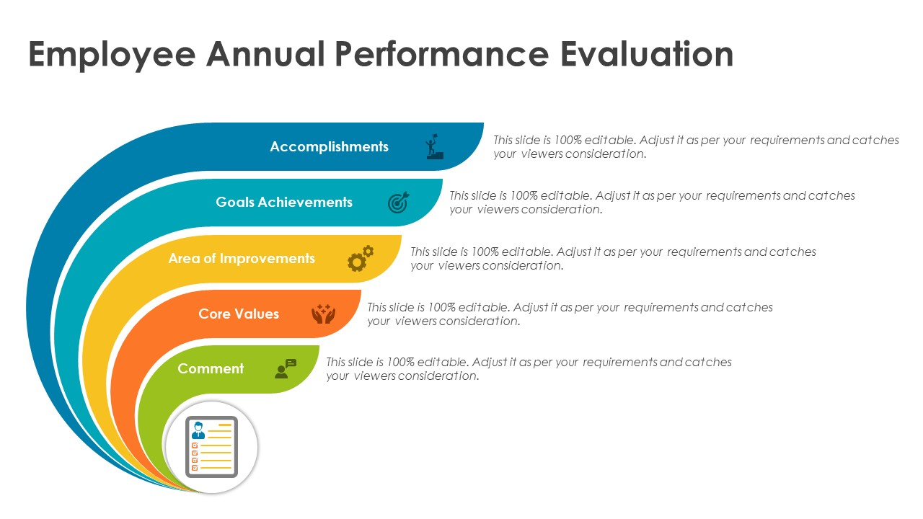
Modelling approach

Slide 9
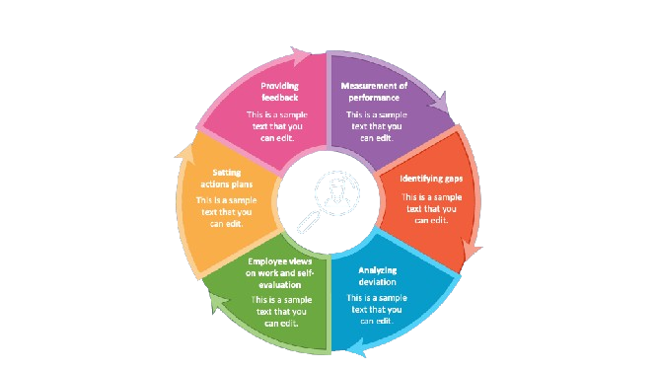
Performance review

Slide 10
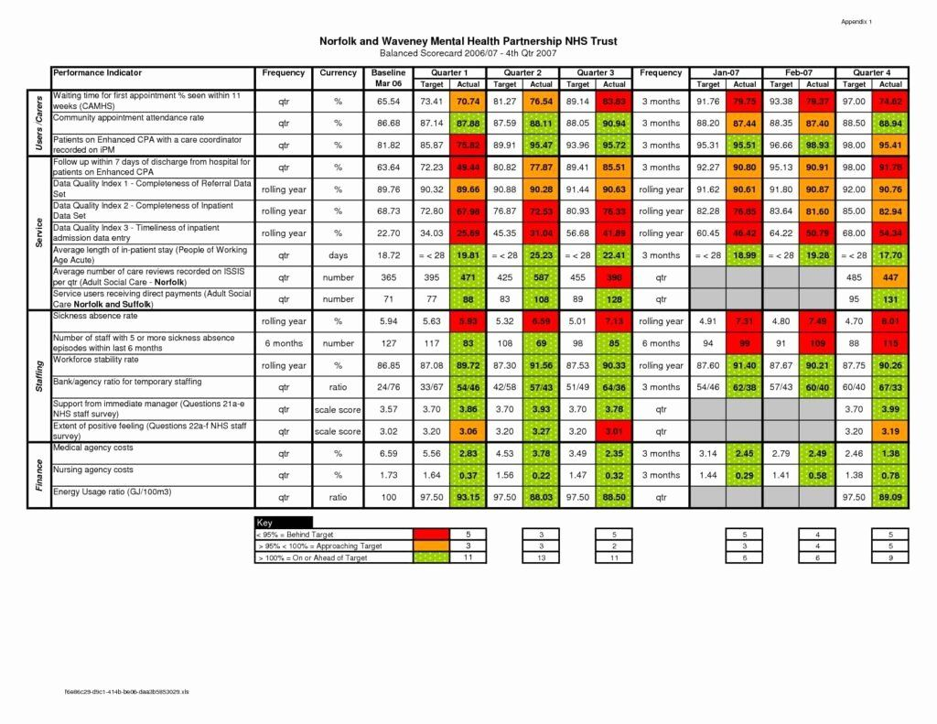
Score card

Slide 11
Results and discussion
Score board provides a holistic view of an organization site program, department, team or employee performance.
Rather then analysing individual key performance indicators(KPIs) a balanced scorecard measures financial,customer and learning process and growth perspectives.

